Slide 1
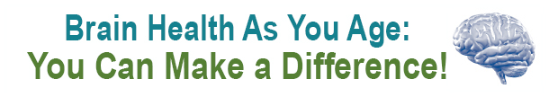



Brain Health AS You Age: You Can Make a Difference!
A presentation by:

Slide 2

Aging and Health
Aging well depends on your:
Genes
Environment
Lifestyle
Healthy lifestyle choices may help you maintain a healthy body and brain

Slide 3

Age-Related Changes in Memory and Learning
You may find:
Increased difficulty finding words
More problems in multi-tasking
Mild decreases in ability to pay attention
You can still:
Learn new things
Create new memories
Improve vocabulary and language skills

Slide 4
Possible Risks or Threats to Brain Health
Some medicines, or improper use of them
Smoking
Excessive use of alcohol
Heart disease, diabetes, and other health problems
Poor diet
Insufficient sleep
Lack of physical activity
Little social activity and being alone most of the time

Slide 5

Medicines and Brain Health
Some medicines – and combinations of them – can affect your thinking and the way your brain works.
Talk with your health care provider about the drugs you take and possible side effects on memory, sleep and brain function.

Slide 6

Smoking and Brain Health
Benefits of quitting smoking at any age:
Lower risk of heart attacks, stroke, and lung disease
Better blood circulation
Not exposing others to second-hand smoke
There are free resources available
to help you quit smoking.

Slide 7

Alcohol’s Effect on Brain Health
Slow or impaired communication among brain cells, even with moderate use
Poor driving, slurred speech, fuzzy memory, drowsiness, dizziness
Long-term changes to balance, memory and emotions, coordination, and body temperature
Staying away from alcohol can reverse some changes.
Some medicines can be dangerous when mixed with alcohol.

Slide 8
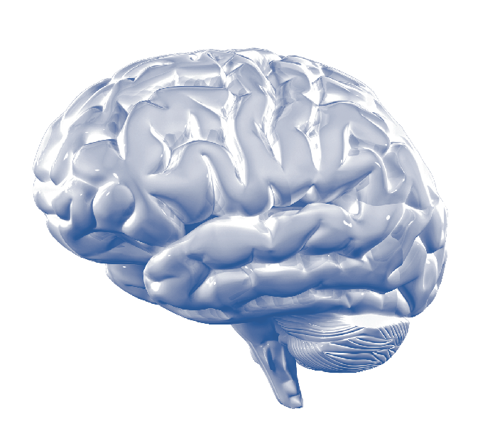
Common Conditions that Affect Brain Health
Heart disease, high blood pressure
Diabetes
Alzheimer’s disease
Stroke
Traumatic brain injury
Depression
Sleep problems

Slide 9

Heart Disease and High Blood Pressure
Heart disease and high blood pressure can lead to stroke and blood vessel changes related to dementia.
How to reduce risk:
Control cholesterol and high blood pressure
Exercise
Eat healthy foods
Quit smoking
Limit use of alcohol

Slide 10
Diabetes
Damages blood vessels throughout your body, including your brain
Increases risk for stroke and heart attack
May increase risk for memory problems and Alzheimer’s disease
Maintaining a healthy weight through physical activity and healthy eating can prevent or control diabetes
Talk with your health care provider about the combination of lifestyle and medicine that works for you.

Slide 11
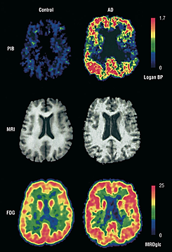
Alzheimer’s Disease
Alzheimer’s is a buildup of harmful proteins in the brain, the death of brain cells, and loss of connections among them.
Known risks:
Age
Genes, in some people
Head injury
Suspected risks:
Heart disease
High blood pressure at mid-life
Lack of physical activity
Depression
Diabetes

Slide 12
Alzheimer’s Disease (continued)
Some therapies can treat Alzheimer’s symptoms. They do not slow down the disease’s changes in the brain.
Some approaches show promise in reducing risk of cognitive decline or Alzheimer’s, but need more testing:
Exercise
Healthy diet
Controlling high blood pressure, heart disease, diabetes
Cognitive “brain” training

Slide 13

Brain Injury
Older adults are at higher risk of falling and other accidents that can cause brain injury
How to reduce risk:
Exercise to improve balance and coordination
Take a fall prevention class
Make your home safer
Review medicines and vision with your health care provider
Wear safety belts and helmets
Get enough sleep

Slide 14

Depression
Feelings of sadness or loss of interest in favored activities that last for weeks at a time
Not a normal part of aging
Some medicines can cause depression
Confusion or attention problems caused by depression can sometimes look like dementia
Treatment can involve therapy and medicine

Slide 15
Sleep Apnea
Short pauses in breathing while sleeping
Can lead to injury, high blood pressure, stroke, or memory loss, all of which can affect brain health
Treatment begins with lifestyle changes, such as avoiding alcohol, losing weight, and quitting smoking
Use of special devices, ordered by your doctor, may also help

Slide 16

So, What Can You Do to Protect Brain Health?
Actions that may help:
Take care of your health
Eat healthy foods
Be active
Learn new things
Connect with family, friends, and communities

Slide 17
Take Care of Your Health
Get recommended health screenings
Manage health problems like diabetes, high blood pressure, and high cholesterol
Consult with your health care provider to make sure your medicines are right for you
Reduce risk for brain injuries due to falls, and other types of accidents
Quit smoking

Slide 18

Eat Healthily
Fruits and vegetables
Whole grains
Lean meats, fish, poultry
Low-fat or non-fat dairy products
Less solid fat, sugar and salt
Proper portion sizes
Adequate fluids
Look into healthy meal programs, like those provided by your Area Agency on Aging.

Slide 19

Get Moving
Physical activity may:
Reduce risks of diabetes, heart disease, depression, and stroke
Prevent falls
Improve connections among brain cells
Get at least 150 minutes of exercise each week. Move about 30 minutes on most days. Walking is a good start.
Join programs that can help you learn to move safely.
Check with your health care provider if you haven’t been active and want to start a vigorous exercise program.

Slide 20

Keep Your Mind Active
Do mentally stimulating activities
Read books and magazines
Play games
Learn new things
Take or teach a class
Be social through work or volunteering
Clinical trials have not proven that these types of activities will prevent Alzheimer’s disease, but they can be fun.

Slide 21
Stay Connected
People who have meaningful activities, like volunteering, say they feel happier and healthier
Social activities are linked to reduced risk for some health problems, including dementia
Join in social and other programs through your Area Agency on Aging, Senior Center, or other community organizations

Slide 22
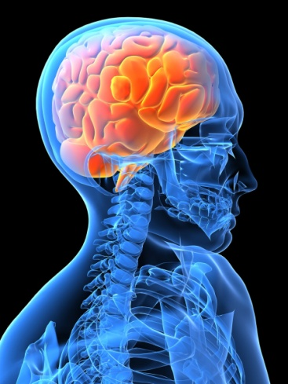
What Can You Do Today?
Pick one thing you can do that may help your brain
Think of small, first steps such as:
Taking a 10-minute walk a few times a week
Adding one serving of vegetables each day
Making an appointment for health screenings or a physical exam
Write down what you will do and when
Get support from family, friends, or community groups!

Slide 23
For More Information
Community Programs:
Contact a local Area Agency on Aging (AAA)
Contact a local Aging & Disability Resource Center (ADRC)
Or, go to http://eldercare.gov/
National Institutes of Health: http://nih.gov
National Institute on Aging at NIH: http://nia.nih.gov
ClinicalTrials.gov, a service of NIH: http://clinicaltrials.gov
Centers for Disease Control and Prevention:
http://www.cdc.gov/aging
http://www.cdc.gov/physicalactivity

